Slide 1
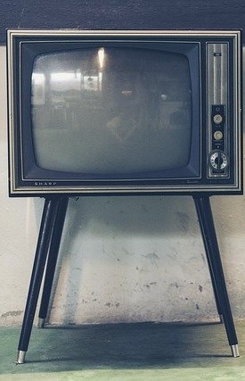
LECTURE TWO (B): BASIC ELEMENTS OF TV
ET 8105 – Television Systems

Slide 2
Introduction
This lecture gives a basic description of TV systems in form and contents.
It just outlines the system
There are two types of TV broadcast systems:
Monochrome (or black and white) TV
Colour TV
Their basic elements are described hereafter
Detailed description of each will follow in the coming lectures.

Slide 3
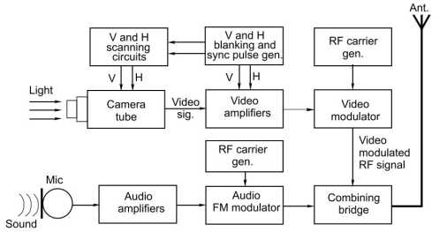
Monochrome TV Transmitter
Basic elements of a monochrome TV transmitting system

Slide 4
Camera Tube - Converts intensity of light from a scene into electrical variations, called video signal by using a photosensitive target plate.
Scanning and Sync Circuits - Electrical current is extracted from the photosensitive target of the camera tube with the help of a scanning beam which is produced by sawtooth currents through horizontal and vertical deflection coils
Blanking and Sync Pulse Generators - The start of sawtooth or sweep current signal is triggered by pulses called sync pulses. The retrace is blanked by blanking pulses and these pulses are periodic and appear for a specified time by using a mono-stable multivibrator.
Video Amplifiers - Video signal along with blanking and sync pulses, called composite video signal is amplified by using wideband RC coupled amplifier circuits.

Slide 5
RF Carrier Generator and Video Modulator - A radio frequency carrier of channel frequency for video is generated and is amplitude modulated by the video signal.
Microphone - It converts sound pressure variations into electrical variations, called audio signals.
Audio Amplifiers - These amplify weak audio signals.
RF Carrier Generator and Audio Modulator - A radio frequency carrier is generated and is frequency modulated by audio signals at low level.
Combining Bridge - Video modulated and audio modulated signals pass through a combining bridge (also called duplexer circuit) to go to a common transmitting antenna.

Slide 6
Transmitting Antenna -Video modulated signal and audio modulated signal are fed to the common transmitting antenna which radiates out the modulated signals into space in the form of electromagnetic waves.

Slide 7
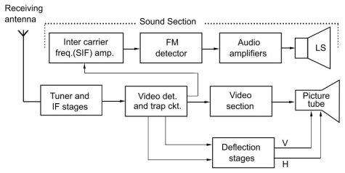
Monochrome TV Receiver
Basic elements of a TV receiver

Slide 8
Receiving Antenna - picks up signal from the electromagnetic waves travelling through space and the desired channel is selected by a tuned circuit.
Tuner and IF Stages -The receiver is a superhetrodyne receiver to achieve high selectivity and high gain.
Video Detector and Trap Circuit – The amplified IF goes to the video detector which recovers the video signal from the modulated wave and feeds it to the video amplifier through the trap circuit, which prevents the video signal from entering into the audio channel.
Video Amplifiers – These are wideband RC coupled amplifiers. The amplified video signal goes to the picture tube.

Slide 9
Picture Tube - The video signal varies the strength of the electron beam. This beam being proportional to the intensity of the video signal.
Deflection Stages - The phosphor dots glow in quick succession from left to right and top to bottom with the help of scanning currents in the deflection coils.
Sound Section – Consists of sound IF (SIF) amplifier, FM detector, audio amplifier and loudspeaker.
Difference of frequency between frequency modulated IF and video carrier IF is called intercarrier frequency, or second IF or sound IF.
It is received from the video detector and passes to the SIF amplifier through the trap circuit, which prevents SIF from going into the video amplifier.

Slide 10
Sound Section – Consists of sound IF (SIF) amplifier, FM detector, audio amplifier and loudspeaker.
The FM detector detects the audio signal which is then amplified by audio amplifiers.
The amplified signal goes to the loudspeaker which converts it into sound.
Thus the original sound is reproduced.

Slide 11
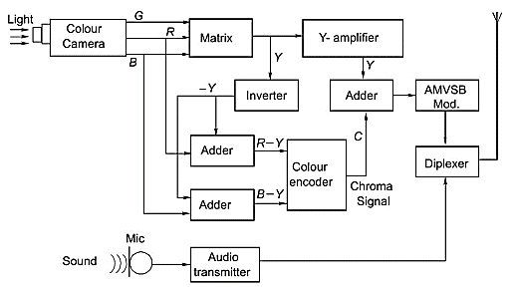
Colour TV Transmitter
Basic blocks of a Colour TV Transmitter

Slide 12
For colour transmission, colours from a picture are separated into three primary colours (red, green and blue) with the help of prisms or dichroic mirrors and colour filters
The brightness present in each colour is converted by colour camera tubes into three electrical signals.
The three colour signals are passed through a resistive matrix to obtain resultant luminance signal (called Y signal), using Grassman’s law.
Colour signals are sent in the form of colour difference signals.
A colour subcarrier (4.43 MHz in European system and 3.58 MHz in American system) is modulated by two colour difference signals (B -Y and R - Y), using synchronous quadrature modulation.

Slide 13
This is called colour encoder and its output is called chroma signal (or C signal).
Then luminance signal Y and chroma signal C are added and modulate the main video carrier signal, using AMVSB technique.
This modulated RF carrier is transmitted along with an audio modulated RF carrier through a common transmitting antenna with the help of a duplexer.

Slide 14
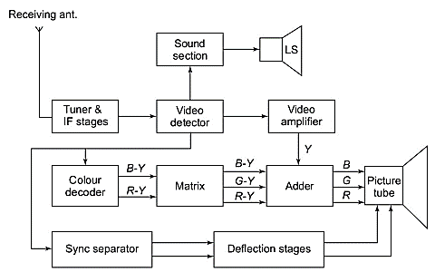
Colour Receiver
Basic blocks of a Colour TV Receiver

Slide 15
A colour receiver is a normal superhetrodyne receiver of the monochrome system up to video detector.
The detector detects Y and C signals. In this section, the C signal is separated by a bandpass filter circuit, amplified, and then the basic colour difference signals (B-Y) and (R-Y), are decoded, using a synchronous quadrature detector.
The third signal (G - Y) is obtained with the help of a resistive matrix.
Then Y signal is added to each of the colour difference signals to get original camera signals pertaining to red, green and blue colours.
These three colour signals are converted into coloured lights by making phosphor elements of the colour picture tube glow red, green and blue for every pixel.

Slide 16
The eye integrates these primary colours by additive mixing and sees the resultant original colour.
Thus the coloured picture is produced on the screen of the picture tube.
Sound is reproduced from the loudspeaker in the same manner as in case of a monochrome receiver.

